Slide 1


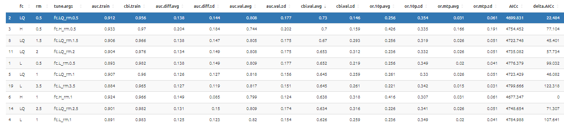
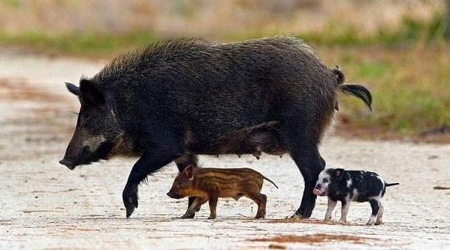
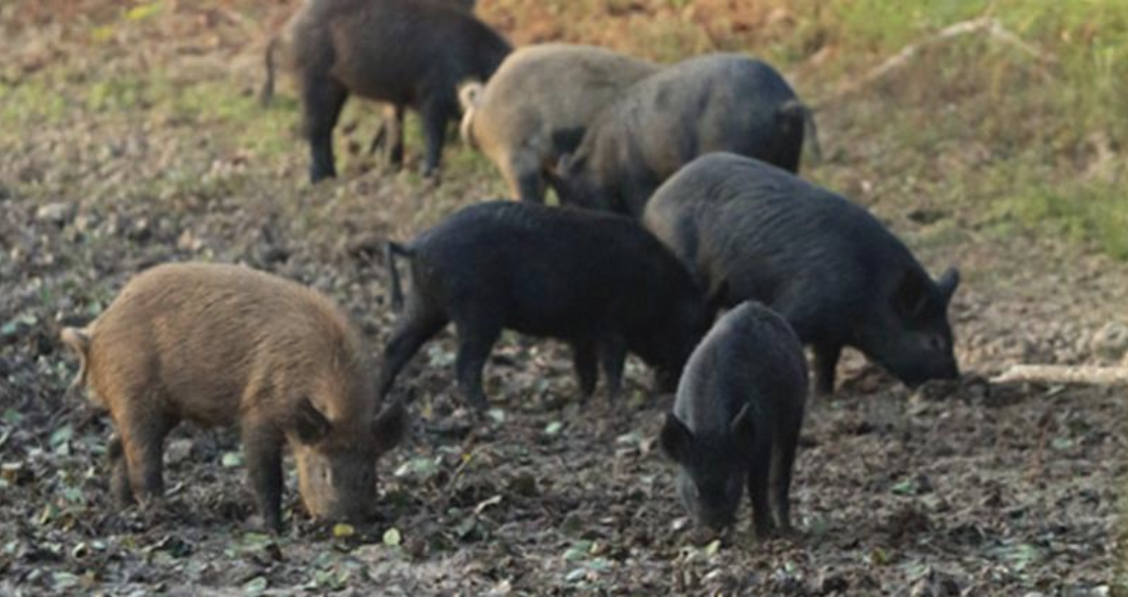
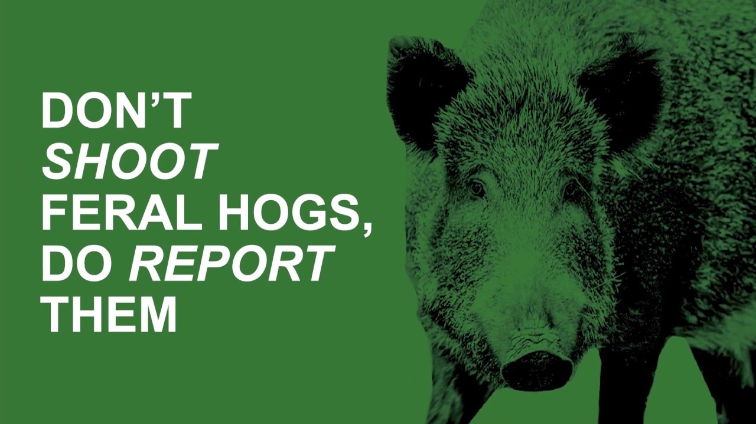

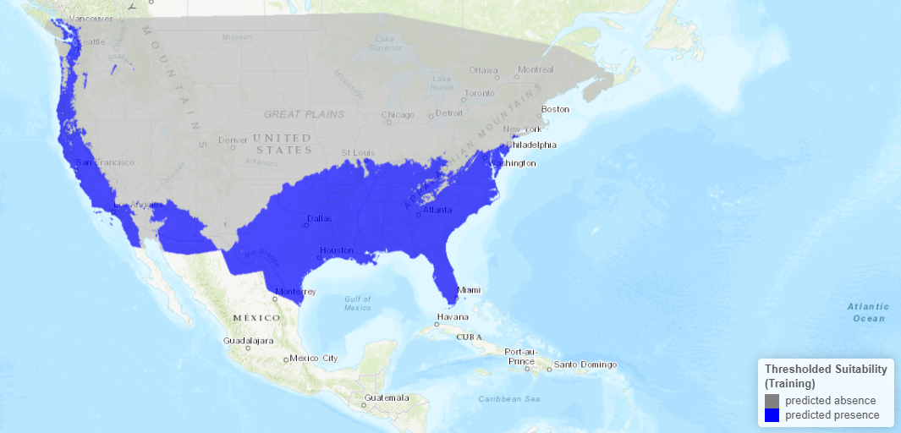
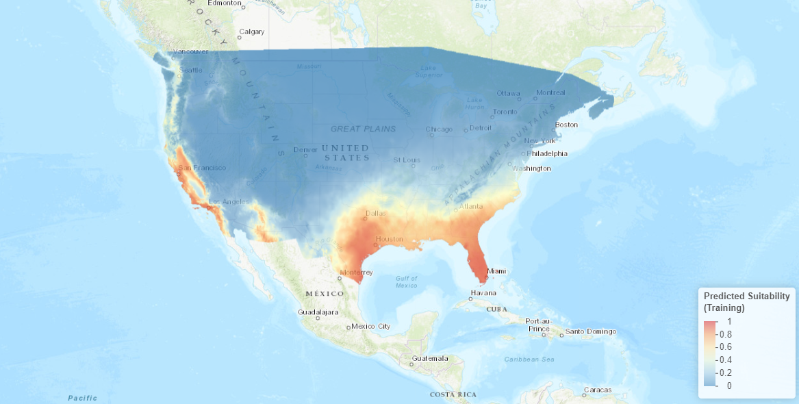
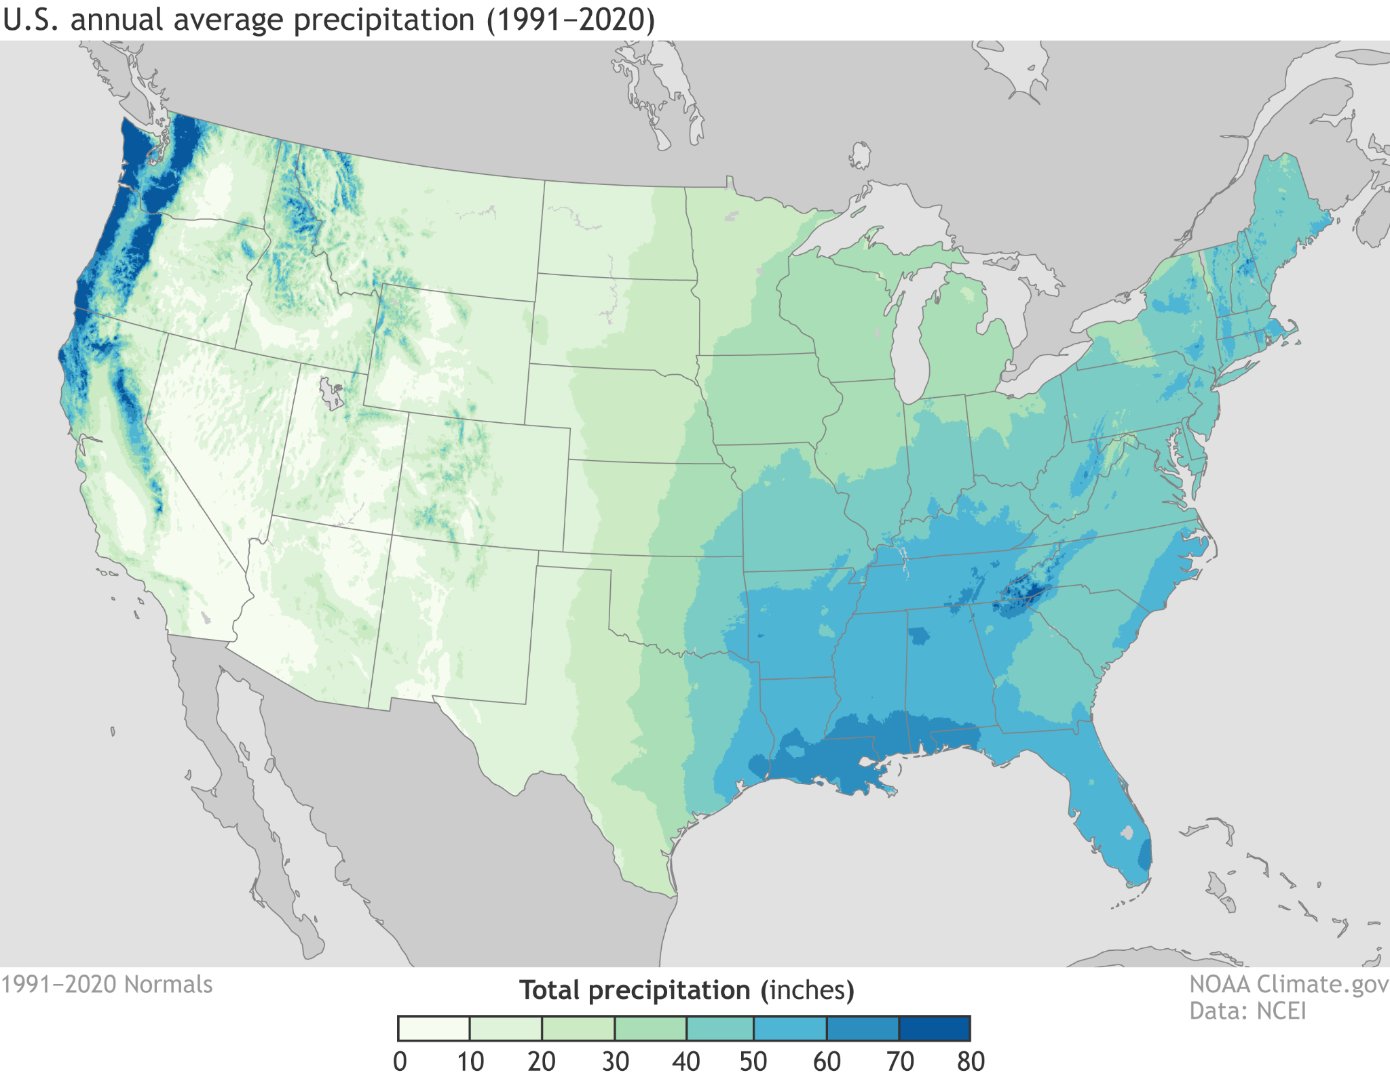
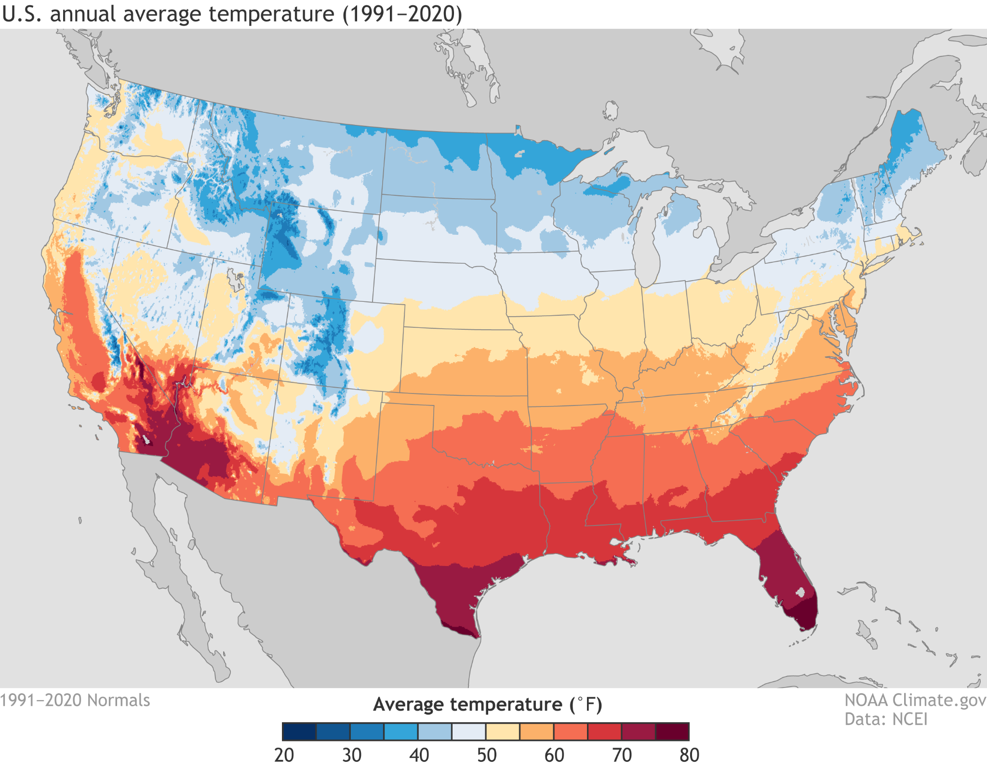
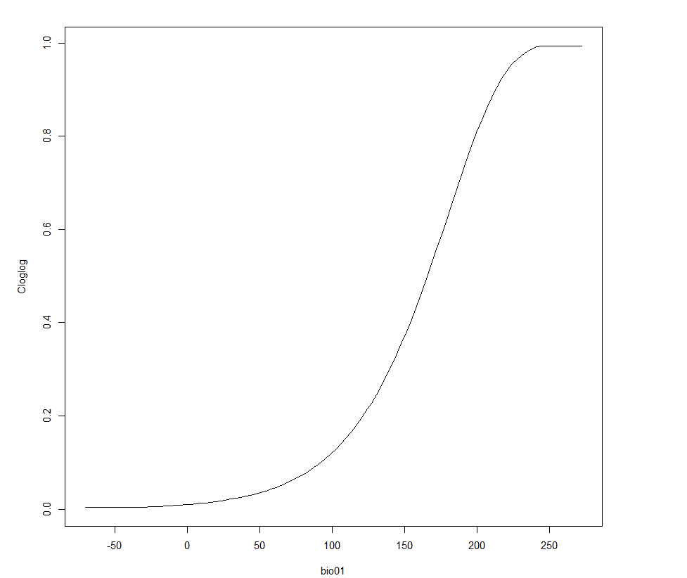
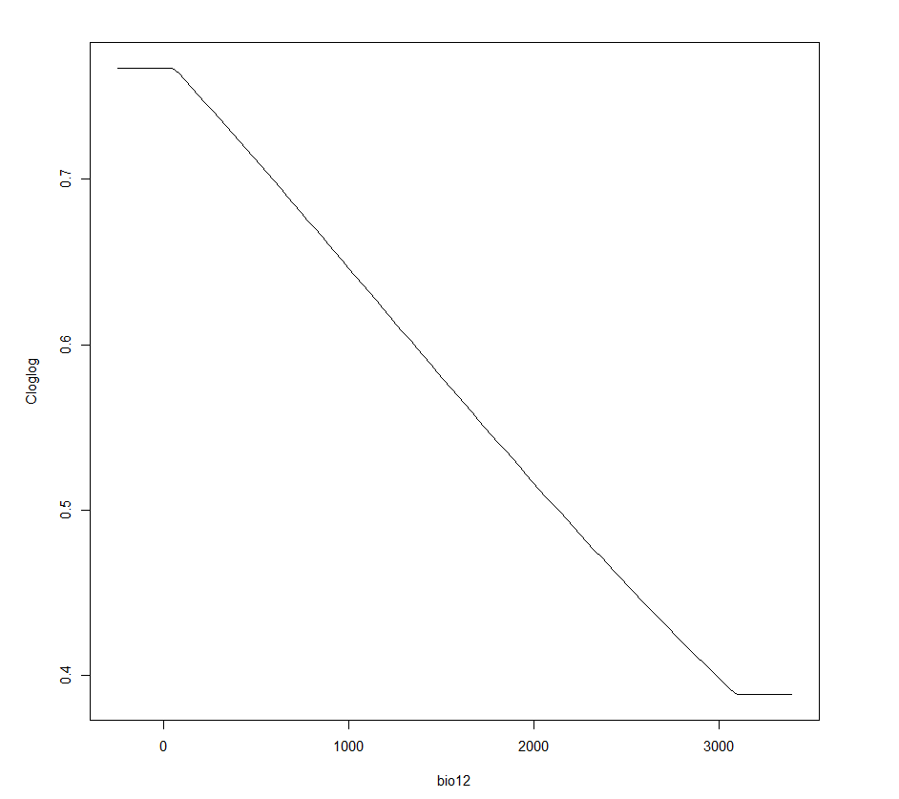
The Effect of Temperature And Precipitation On The Distribution of Feral Swine Population: A Machine Learning Method
Jason Jiang and Dr. Zeynep Benderlioglu
Department of Evolution, Ecology, & Organismal Biology
Introduction:
Methods:
Discussion :
Feral Swine are an invasive species to the United States, with a population of about 7 million spread across 35 states.
Feral Swine population can have severe negative impacts:
$2.5 billion dollars in damages to crops, livestock, and pastures annually ¹
Feral swine produce an annual mean emission of 16.87 million metric tons of carbon dioxide, which is equivalent to those emitted by 3.7 million passenger vehicles ²
Carry up to 30 diseases and 40 parasites, such as hepatitis E and brucellosis ³
In an ideal environment, feral swine population can double in 4 months, and are able to start breeding at just 6 months of age. ⁴
Recent rapid range expansion is a result of illegal transport and release of feral swine and other human mediated landscape changes
Purpose:
To predict feral swine population distribution across the US by building upon past studies⁵ and use a machine learning model that utilizes environmental factors to map species’ distributions.
To provide industry professionals, government institutions, and academics with useful and accurate models that they can use to anticipate the range expansion of feral swine, which will in turn aid the relevant organizations to establish informed policies on invasive species.
The feral swine population distribution across the US is in accordance with predictions. A higher number of feral swine were found in areas with hotter temperatures and greater levels of precipitation. Outlier to this prediction, was the northwestern region, perhaps explainable due to lower temperatures. It can be concluded that temperature is a greater predictor of feral swine presence and suitability than precipitation.
Broader Implications:
Data on feral swine distribution will help wildlife disease biologists, climate scientists, and agriculturalists to make more informed decisions in their fields.
The study will also contribute to prevention efforts, early detection and rapid responses, and policy making
Future Directions:
Future research could focus on improving the accuracy/precision of the model, validating the model, and integrating other modeling techniques.
Incorporating additional variables
Accounting for temporal dynamics
Refining the spatial resolution
Machine learning methods are being continuously improved as time goes on, in the future, there could be even more accurate ML algorithms for species distribution.
Studying the impacts of climate change: As the climate changes, feral swine distributions and behavior may also change.
R-based software application Wallace was used to create the machine learning models and visualize the species distribution
Data Collection:
The species’ occurrence data came from the Global Biodiversity Information Facility database that is collected from observations in the field. The environmental data were gathered from WorldClim, a global climate database that records different bioclimatic variables from multiple weather stations worldwide. Data cleaning tools were then used to process occurrence and environmental data for better modeling.
MaxEnt Algorithm:
The MaxEnt Algorithm was then used to build the distribution models. This machine learning method maximizes uncertainty (entropy), in order to make the fewest assumptions possible about the species distribution. This ensures that the model is as general as possible, allowing it to produce conservative predictions and account for complex interactions between temperature and precipitation.
Choosing the Best Model:
After the models were produced, the best one was chosen by examining the model performance statistics AUC (Area Under the Curve), OR (Omission Rate), and CBI (Continuous Boyce Index) that were calculated and averaged. All 3 measurements and trade-offs between them were considered to choose the best model.
A
B
Figure 3: Performance statistics of the 24 different models created.
A
B
A
B
Results:
A
B
A
B
Figure 1: (A) Adult feral swine and her piglets, (B) Wild feral swine pack rooting through a field
Hypothesis:
Figure 6: (A) Infographic made by the Mark Twain National Forest advocating for feral hog reporting over hunting, (B) Official USDA icon for feral swine control
I hypothesize that the feral swine population will inhabit areas with higher levels of precipitation and warmer temperatures across the US. This prediction is further supported by the fact that feral swine tend to inhabit swamps and brushlands where they benefit from precipitation to cool down and humid temperatures to root through softer soil.
References:
Daniels, Jeff. Feral Hogs Cause up to $2.5 Billion in Damage a Year, so the Government Is Boosting Efforts to Fight Them | Wild Pigs. wildpigs.nri.tamu.edu/news/2018/august/feral-hogs-cause-up-to-25-billion-in-damage-a-year-so-the-government-is-boosting-efforts-to-fight-them.
O’Bryan, Corliss A., et al. “Unrecognized Threat to Global Soil Carbon by a Widespread Invasive Species.” Global Change Biology, vol. 28, no. 3, Wiley-Blackwell, Feb. 2022, pp. 877–82.
USDA APHIS | Feral Swine- Risks to People and Domestic Animals. www.aphis.usda.gov/aphis/ourfocus/wildlifedamage/operational-activities/feral-swine/feral-swine-damage/feral-swine-risks-pets-people.
Wild Pig Biology | Internet Center for Wildlife Damage Management. icwdm.org/species/other-mammals/wild-pigs/wild-pig-biology/#:~:text=In%20ideal%20conditions%2C%20a%20population,have%20a%20high%2Dquality%20diet.
Snow, Nathan P., et al. “Interpreting and Predicting the Spread of Invasive Wild Pigs.” Journal of Applied Ecology, vol. 54, no. 6, Wiley-Blackwell, Dec. 2017, pp. 2022–32. https://doi.org/10.1111/1365-2664.12866.
Figure 4: (A) Presence vs Absence map (B) Gradient map of predicted suitability
A
B
A
B
Figure 2: (A) Annual average precipitation map from 1991-2020 (B) Annual average temperature map from 1991-2020
Figure 4: (A) Response curve that shows predicted suitability (y-axis) changes vs Temperature (x-axis) (B) Response curve that shows predicted suitability (y-axis) changes vs Precipitation (x-axis)

